Slide 1
Cloud Platforms - II
Google App Engine

Slide 2
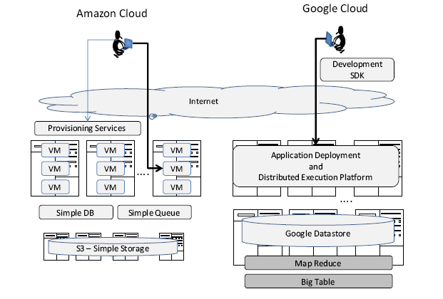
IAAS vs PAAS

Slide 3
Essential features of a `Cloud’ service
“pay-per-use” - different model from IAAS
rapid end-user provisioning - code not VMs
commoditized service – application based

Slide 4
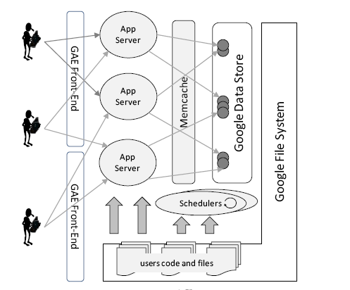
Google App Engine

Slide 5
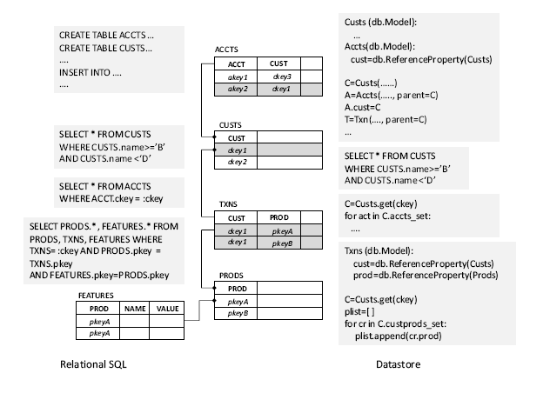
Google Data Store

